Slide 1
Maps
Objects as Maps | For-in Loop | Other Object Map Properties | Map Objects
Notes:
Welcome to our lecture on Maps. In this lecture, we will cover key concepts, including using objects as maps, iterating through properties with the for-in loop, exploring additional object map properties, and understanding the advanced features of Map objects. Let’s start our lecture.

Slide 2
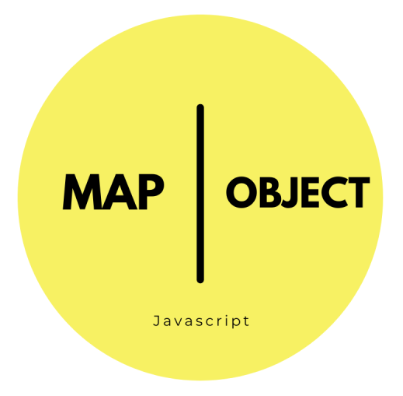
Object As Maps
Map Definition: A map (or associative array) is a data structure that maps keys to values, with each key/value pair referred to as an element.
Objects as Maps: In JavaScript, objects can function as maps, where the key is the property name, and the value is the property's value.
Accessing Elements: Individual elements in an object-as-map can be accessed using bracket notation, e.g., myMap["key"].
Notes:
Let us explore objects as maps. A map is a data structure that associates keys with values, treating each pair as an element. In JavaScript, objects can function as maps, where keys are property names and values are property values. Elements in an object-as-map can be accessed using bracket notation, such as my Map with value key. This approach allows for efficient data storage and retrieval.

Slide 3
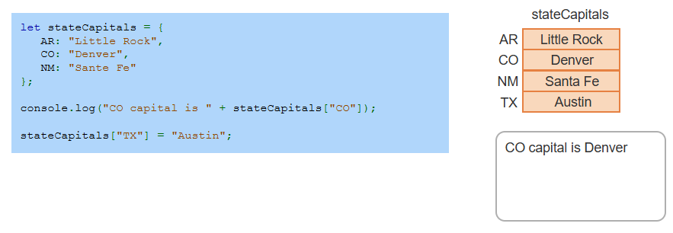
Example
Notes:
Here is an example of using an object as a map in JavaScript. The stateCapitals object stores state abbreviations as keys and their capitals as values. Using bracket notation, we can access values, such as stateCapitals["CO"], which outputs Denver. Additionally, we can add new key-value pairs, like setting stateCapitals["TX"] to Austin. This demonstrates how objects serve as simple and efficient maps.

Slide 4
For-in Loop
Purpose: The for-in loop is used to iterate over an object's properties in arbitrary order, making it ideal for looping through object map elements.
Syntax: The loop declares a variable on the left side of the in keyword and an object on the right.
Iteration: During each iteration, the variable is assigned the name of one of the object's properties.
Notes:
Let us look at the for-in loop, which is used to iterate over an object's properties in arbitrary order. This makes it ideal for traversing object map elements. The syntax involves a variable on the left side of the in keyword and an object on the right. During each iteration, the variable is assigned the name of one of the object's properties, allowing us to access or manipulate its values.

Slide 5
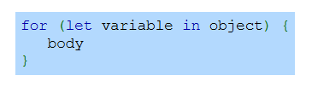
For-In Loop Syntax
Notes:
Here is the syntax for the for-in loop in JavaScript. The loop begins with the for keyword, followed by parentheses. Inside the parentheses, a variable is declared using let, followed by the in keyword and the object to iterate over. The loop body, enclosed in curly braces, contains the code to execute for each property in the object. This structure is used to access and process object properties.

Slide 6
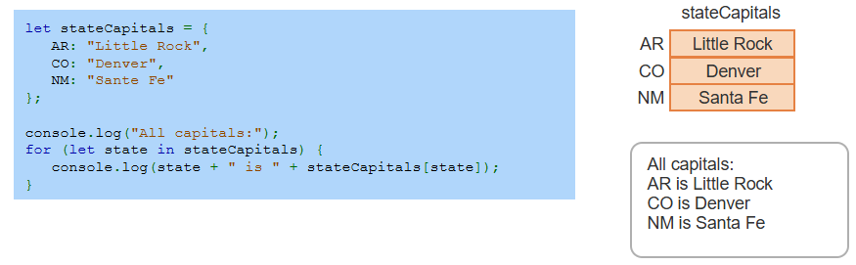
Example
Notes:
Here is an example of using the for-in loop to iterate through an object's properties. The stateCapitals object stores state abbreviations as keys and their capitals as values. The loop iterates over each key in the object, logging both the state abbreviation and its corresponding capital. This demonstrates how the for-in loop efficiently accesses all properties of an object.

Slide 7
Other object map operations
Other common operations performed on object maps include:
Get Number of Elements: Use Object.keys(obj).length to get the number of properties in an object, as Object.keys() returns an array of property names.
Check for Key: Use the in operator to check if an object contains a specific property ("key" in obj returns true or false).
Remove Element: Use the delete operator to remove a key/property from an object or map (delete obj.key).
Notes:
In addition to iteration, there are other key operations for object maps. To get the number of properties in an object, use Object dot keys into OBJ dot length. To check if a property exists, use the in operator, for example, key in OBJ. To remove a property, use the delete operator, such as delete OBJ dot key. These operations enhance the flexibility and functionality of working with object maps.

Slide 8
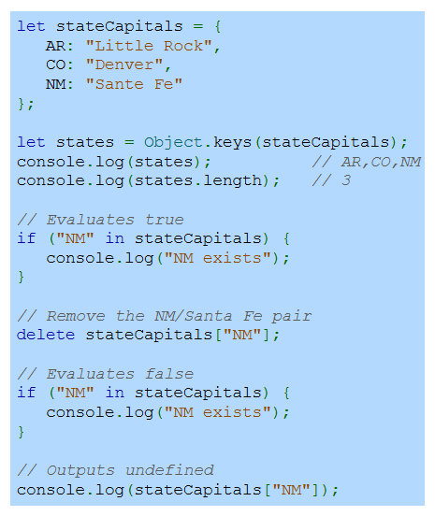
Example
Notes:
Here is an example demonstrating common object map operations. The Object dot keys method retrieves all keys, while its length gives the count. The in operator checks if a key, like NM exists. The delete operator removes a key-value pair, such as NM. After deletion, checking for NM evaluates to false, and accessing its value returns undefined. This highlights key operations for managing object maps.

Slide 9
Map object
The Map object is a modern alternative for storing key-value pairs with useful methods and properties include:
set(key, value): Adds or updates a key-value pair in the map.
get(key): Retrieves the value associated with a key.
has(key): Returns true if the map contains the key, otherwise false.
delete(key): Removes a key-value pair from the map.
size: Returns the number of elements in the map.
Notes:
The Map object is a modern and efficient way to store key-value pairs in JavaScript, offering enhanced functionality compared to plain objects. Key methods include set to add or update entries, get to retrieve values, has to check for key existence, and delete to remove entries. The size property provides the count of elements. These features make Map objects versatile for managing dynamic data.

Slide 10
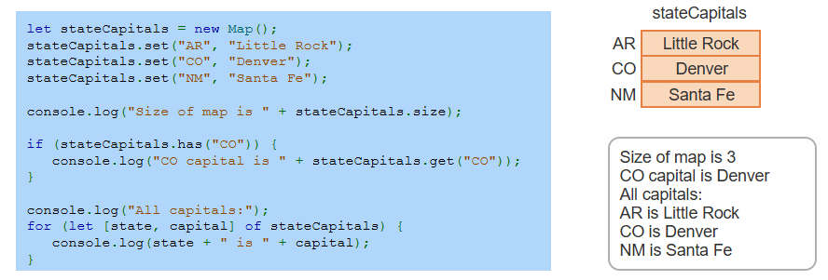
Example
Notes:
This example demonstrates using the Map object in JavaScript. The set method adds key-value pairs like state abbreviations and capitals. The size property shows the total number of entries. The has method checks if a key exists, and get retrieves its value. A for-of loop iterates through all entries, displaying state abbreviations and their capitals. This highlights the Map object’s flexibility and efficiency. Thanks for watching the lecture.

